Slide 1
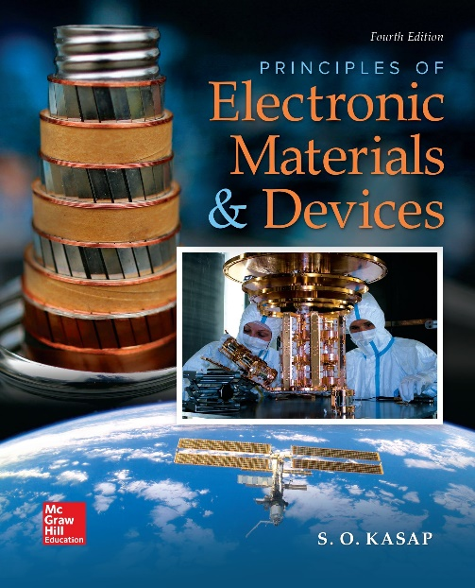
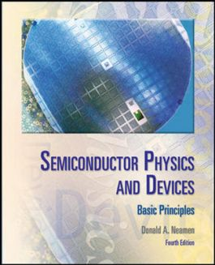

ELECTRONIC MATERIALS AND DEVICES
L | T | P | J | C
3 | 0 | 0 | 0 | 3
Dr. M. Saranya Nair
School of Electronics Engineering
VIT-Chennai Campus
E-mail : saranyanair.m@vit.ac.in
MODULE 2

Slide 2
ELECTRONIC MATERIALS AND DEVICES
MODULE 2
Semiconductor Fundamentals
Introduction to Solids, Crystals, and Electronic materials – Formation of energy bands – Energy band Model – Effective mass - Direct and indirect bandgap – Elemental and compound semiconductors, Intrinsic and extrinsic semiconductors. The density of states, Carrier statistics, Fermi level, Equilibrium carrier concentration, Quasi-equilibrium, and Quasi-Fermi level.

Slide 3
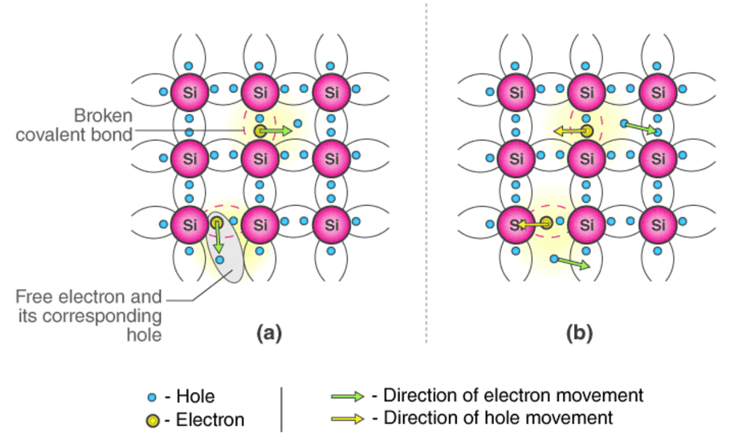
Semiconductors
Semiconductors are the materials which have a conductivity between conductors (generally metals) and non-conductors or insulators (such as ceramics).
An intrinsic type of semiconductor material is made to be very pure chemically. It is made up of only a single type of element.
Germanium (Ge) and Silicon (Si) are the most common type of intrinsic semiconductor elements. They have four valence electrons (tetravalent). They are bound to the atom by covalent bond at absolute zero temperature.
When the temperature rises, few electrons are unbounded and become free to move through the lattice, thus creating an absence in its original position (hole). These free electrons and holes contribute to the conduction of electricity in the semiconductor.
The thermal energy is capable of ionizing a few atoms in the lattice, and hence their conductivity is less.

Slide 4
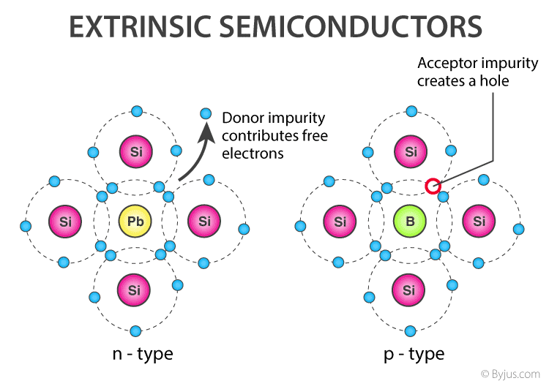
Extrinsic Semiconductor
The conductivity of semiconductors can be greatly improved by introducing a small number of suitable replacement atoms called IMPURITIES. The process of adding impurity atoms to the pure semiconductor is called DOPING.
Usually, only 1 atom in 10⁷ is replaced by a dopant atom in the doped semiconductor. An extrinsic semiconductor can be further classified into:
N-type Semiconductor
P-type Semiconductor
When a pure semiconductor (Silicon or Germanium) is doped by pentavalent impurity (P, As, Sb, Bi) then, four electrons out of five valence electrons bonds with the four electrons of Ge or Si.
The fifth electron of the dopant is set free. Thus, the impurity atom donates a free electron for conduction in the lattice and is called “Donar”.

Slide 5
Since the number of free electron increases by the addition of an impurity, the negative charge carriers increase. Hence, it is called n-type semiconductor.
As conduction is due to a large number of free electrons, the electrons in the n-type semiconductor are the MAJORITY CARRIERS and holes are the MINORITY CARRIERS.
When a pure semiconductor is doped with a trivalent impurity (B, Al, In, Ga ) then, the three valence electrons of the impurity bonds with three of the four valence electrons of the semiconductor.
This leaves an absence of electron (hole) in the impurity. These impurity atoms which are ready to accept bonded electrons are called “Acceptors”.
With the increase in the number of impurities, holes (the positive charge carriers) are increased. Hence, it is called p-type semiconductor.
As conduction is due to a large number of holes, the holes in the p-type semiconductor are MAJORITY CARRIERS and electrons are MINORITY CARRIERS.
In intrinsic semiconductors, the number of excited electrons is equal to the number of holes; n = p = n_{i}.
They are also termed as undoped semiconductors or i-type semiconductors.

Slide 6
Here, the n_{i} gives the number of total intrinsic carrier concentration which is equal to the total number of holes or the total number of electrons.
When the temperature of an intrinsic semiconductor is T=0K, it behaves like an insulator. When the temperature is increased further, (T>0K), the electrons get excited and move from the valence band to the conduction band. These electrons occupy the conduction band partially, leaving a correspondingly equal number of holes in the valence band.
What is the ENERGY BAND IN SOLIDS?

Slide 7
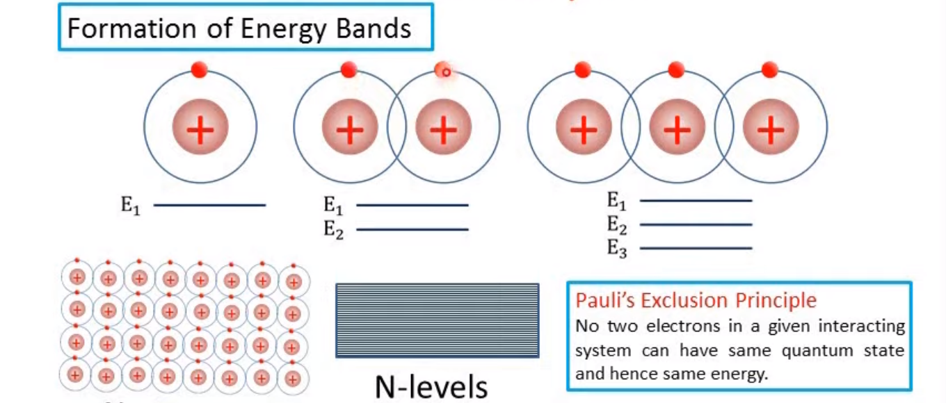
Formation of Energy Bands

Slide 8
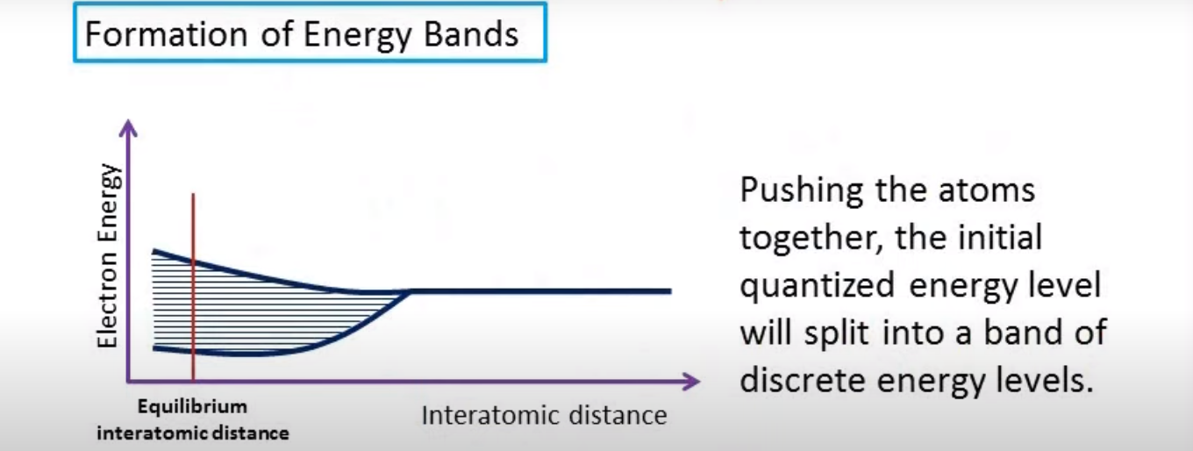

Slide 9

The electrons of the two atoms overlap, which means that the two electrons will interact. This interaction or perturbation results in the discrete quantized energy level splitting into two discrete energy levels.
The splitting of the discrete state into two states is consistent with the Pauli exclusion principle.

Slide 10
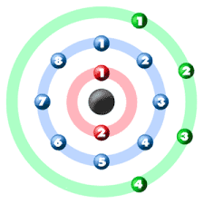
Band splitting of silicon
We have bands of allowed energies that the electrons may occupy separated by bands of forbidden energies. This energy-band splitting and the formation of allowed and forbidden bands is the energy-band theory of single-crystal materials

Slide 11
Band splitting of silicon
Ten of the 14 silicon atom electrons occupy deep-lying energy levels close to the nucleus. The four remaining valence electrons are relatively weakly bound and are the electrons involved in chemical reactions.
We need only consider the n = 3 level for the valence electrons, since the first two energy shells are completely full and are tightly bound to the nucleus.
The 3s state corresponds to n = 3 and l = 0 and contains two quantum states per atom. This state will contain two electrons at T = 0 K.
The 3p state corresponds to n = 3 and l = 1 and contains six quantum states per atom. This state will contain the remaining two electrons in the individual silicon atom.

Slide 12
As the interatomic distance decreases, the 3s and 3p states interact and overlap.
At the equilibrium interatomic distance, the bands have again split, but now four quantum states per atom are in the lower band and four quantum states per atom are in the upper band.
At absolute zero, electrons are in the lowest energy state, so that all states in the lower band (the valence band) will be full and all states in the upper band (the conduction band) will be empty.
The bandgap energy Eg between the top of the valence band and the bottom of the conduction band is the width of the forbidden energy band.
The formation of these energy bands is directly related to the electrical characteristics of the crystal

Slide 13
The Energy Band and the Bond Model
All of the valence electrons schematically are in the valence band.
The upper energy band, the conduction band, is completely empty at T = 0 K.
As the temperature increases above 0 K, a few valence band electrons may gain enough thermal energy to break the covalent bond and jump into the conduction band.

Slide 14
E-k Diagram
The energy states in the valence band are completely full and the states in the conduction band are empty.
Figure 3.14b shows these same bands for T > 0 K, in which some electrons have gained enough energy to jump to the conduction band and have left empty states in the valence band.

Slide 15
Electron Effective Mass
The movement of an electron in a lattice will be different from that of an electron in free space.
In addition to an externally applied force, there are internal forces in the crystal which will influence the motion of electrons in the lattice.
Ftotal = Fext + Fint = ma
where Ftotal , Fext , and Fint are the total force, the externally applied force, and the internal forces, respectively, acting on a particle in a crystal. The parameter a is the acceleration and m is the rest mass of the particle.
Since it is difficult to take into account all of the internal forces, we will write the equation
Fext = m*a
where the acceleration a is now directly related to the external force. The parameter m*, called the effective mass, takes into account the particle mass and also takes into account the effect of the internal forces.
m*a = -eE

Slide 16
Metals, Insulators, and Semiconductors
Figure a shows an allowed energy band that is completely empty of electrons. If an electric field is applied, there are no particles to move, so there will be no current.
Figure b shows another allowed energy band whose energy states are completely full of electrons. A completely full energy band will also not give rise to a current.
A material that has energy bands either completely empty or completely full is an insulator. There are essentially no charged particles that can contribute to a drift current.
The bandgap energy Eg of an insulator is usually on the order of 3.5 to 6 eV or larger, so that at room temperature, there are essentially no electrons in the conduction band and the valence band remains completely full.
There are very few thermally generated electrons and holes in an insulator.

Slide 17

Figure a shows an energy band with relatively few electrons near the bottom of the band. Now, if an electric field is applied, the electrons can gain energy, move to higher energy states, and move through the crystal. The net flow of charge is a current.
Figure b shows an allowed energy band that is almost full of electrons, which means that we can consider the holes in this band. If an electric field is applied, the holes can move and give rise to a current.
Figure c shows the simplified energy-band diagram for this case. The bandgap energy may be on the order of 1 eV.

Slide 18
The characteristics of a metal include a very low resistivity.
The energy-band diagram for a metal may be in one of two forms. Figure a shows the case of a partially full band in which there are many electrons available for conduction, so that the material can exhibit a large electrical conductivity.
Figure b shows another possible energy-band diagram of a metal. The band splitting into allowed and forbidden energy bands is a complex phenomenon, in which the conduction and valence bands overlap.
As in the case shown in Figure a, there are large numbers of electrons as well as large numbers of empty energy states into which the electrons can move, so this material can also exhibit a very high electrical conductivity.

Slide 19
What is Fermi Level?
The highest energy level that an electron can occupy at the absolute zero temperature is known as the Fermi Level. The Fermi level lies between the valence band and conduction band because at absolute zero temperature the electrons are all in the lowest energy state. Due to lack of sufficient energy at 0 Kelvin, the Fermi level can be considered as the sea of fermions (or electrons) above which no electrons exist. The Fermi level changes as the solids are warmed and when electrons are added to or withdrawn from the solid.
The closer the Fermi level is to the conduction band energy, the easier it will be for electrons in the valence band to transition into the conduction band.

Slide 20
DENSITY OF STATES
Since current is due to the flow of charge, an important step in the process is to determine the number of electrons and holes in the semiconductor that will be available for conduction.
The number of carriers that can contribute to the conduction process is a function of the number of available energy or quantum states.
When we discussed the splitting of energy levels into bands of allowed and forbidden energies, we indicated that the band of allowed energies was actually made up of discrete energy levels. We must determine the density of these allowed energy states as a function of energy in order to calculate the electron and hole concentrations.
We are going to use the density of quantum states in the conduction band and the density of quantum states in the valence band to determine the concentration of electrons and holes in the conduction and valence bands.

Slide 21
We use the density of quantum states in the conduction band and the density of quantum states in the valence band along with the Fermi–Dirac probability function to determine the concentration of electrons and holes in the conduction and valence bands, respectively.
Equilibrium Distribution of Electrons and Holes
Equilibrium, or thermal equilibrium, implies that no external forces such as voltages, electric fields, magnetic fields, or temperature gradients are acting on the semiconductor.
The distribution of electrons in the conduction band is given by the density of allowed quantum states times the probability that a state is occupied by an electron. This statement is written in equation form as
n(E) = g_{c}(E)f_{F} (E)
where f_{F}(E) is the Fermi–Dirac distribution and g_{c}(E) is the density of quantum states in the conduction band. The total electron concentration per unit volume in the conduction band is then found by integrating Equation over the entire conduction-band energy.

Slide 22
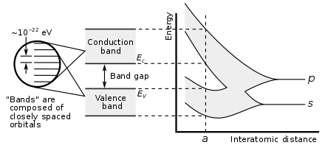
Similarly, the distribution (with respect to energy) of holes in the valence band is the density of allowed quantum states in the valence band multiplied by the probability that a state is not occupied by an electron. We may express this as
p(E) = g_{v}(E)[1-f_{F} (E)]
The total hole concentration per unit volume is found by integrating this function over the entire valence-band energy.
The equation for the thermal equilibrium concentration of electrons may be found by integrating n(E) over the conduction band energy,
The lower limit of integration is Ec and the upper limit of integration should be the top of the allowed conduction band energy, we can take the upper limit of integration to be infinity.

Slide 23
Fermi probability function reduces to the Boltzmann approximation as Maxwell- Boltzmann distribution is the commonly used Fermi Dirac distribution approximation.
The parameter m_{n}* is the effective mass of the electron. The parameter Nc is called the effective density of states function in the conduction band.

Slide 24
Equilibrium Distribution of Holes

Slide 25
Calculate the thermal-equilibrium hole concentration in silicon at T = 400 K.
Assume that the Fermi energy is 0.27 eV above the valence-band energy.

Slide 26
Calculate the thermal equilibrium concentrations of electrons and holes for a given Fermi energy.
Consider silicon at T = 300 K, Assume that the Fermi energy is 0.22 eV below the conduction band.

Slide 27
DA4 :
Determine the thermal-equilibrium concentrations of electrons and holes in silicon at T = 300 K if the Fermi energy level is 0.215 eV above the valence-band energy

Slide 28
The Intrinsic Carrier Concentration
For an intrinsic semiconductor, the concentration of free electrons is equal to the concentration of holes in the valence band.
We may denote ni and pi as the electron and hole concentrations, respectively, in the intrinsic semiconductor.
These parameters are usually referred to as the intrinsic electron concentration and intrinsic hole concentration. However, ni = pi, so normally we simply use the parameter ni as the intrinsic carrier concentration, which refers to either the intrinsic electron or hole concentration.
The Fermi energy level for the intrinsic semiconductor is called the intrinsic Fermi energy, or E_{F} = E_{Fi}

Slide 29
DA 5:
Calculate the intrinsic carrier concentration in silicon at T = 250 K.
Assume the bandgap energy of silicon is 1.12 eV

Slide 30
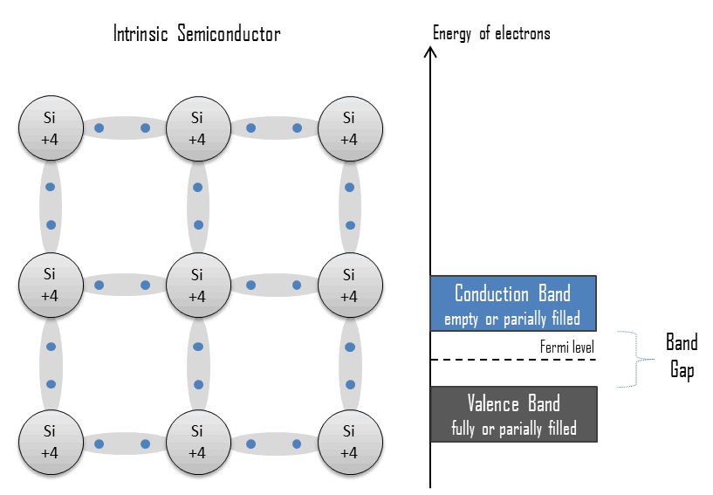
Energy Band Structures Intrinsic Semiconductor
In the energy band diagram, the conduction band is empty (usually) whereas the valence band is filled totally.
Once the temperature is increased, some heat energy can be supplied to it. So the electrons from the valence band are supplied toward the conduction band by leaving the valence band.

Slide 33
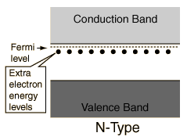
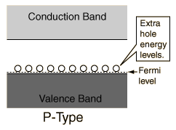
Energy Band Structures Extrinsic Semiconductor
The addition of donor impurities contributes more free electrons in the semiconductor which shifts the effective Fermi level above the intrinsic level. The addition of acceptor impurities contributes more holes in the semiconductor which shifts the effective Fermi level below the intrinsic level

Slide 34
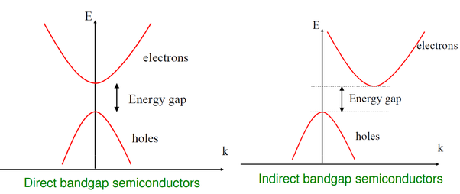
Direct & Indirect Bandgap Semiconductor
The band gap represents the minimum energy difference between the top of the valence band and the bottom of the conduction band. In a direct band gap semiconductor, the top of the valence band and the bottom of the conduction band occur at the same value of momentum. In an indirect band gap semiconductor, the maximum energy of the valence band occurs at a different value of momentum to the minimum in the conduction band energy

Slide 35
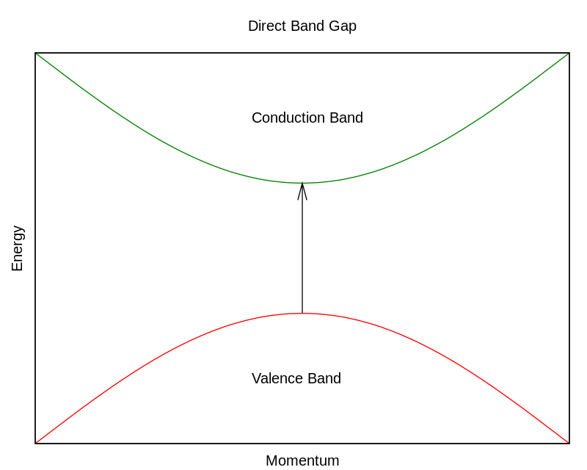
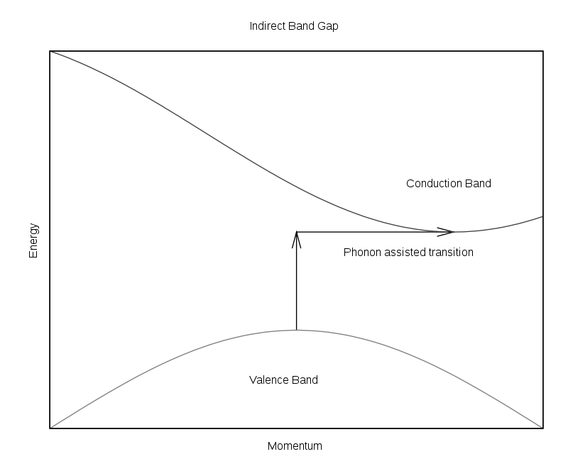
A photon of energy E_{g}, where E_{g} is the band gap energy, can produce an electron-hole pair in a direct band gap semiconductor quite easily, because the electron does not need to be given very much momentum. However, an electron must also undergo a significant change in its momentum for a photon of energy E_{g} to produce an electron-hole pair in an indirect band gap semiconductor. This is possible, but it requires such an electron to interact not only with the photon to gain energy, but also with a lattice vibration called a phonon in order to either gain or lose momentum.

Slide 36
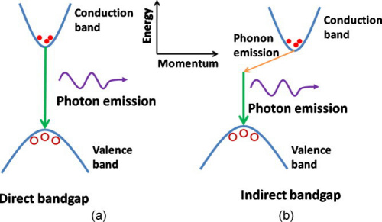
The same principle applies to recombination of electrons and holes to produce photons. The recombination process is much more efficient for a direct band gap semiconductor than for an indirect band gap semiconductor, where the process must be mediated by a phonon.
As a result of such considerations, direct band gap semiconductors are used to make optical devices such as LEDs and semiconductor lasers, whereas silicon, which is an indirect band gap semiconductor, is not.

Slide 37

Module II Mathematical Relations for Problems
= e N_{d} μ_{e} for N-type semiconductor
= e N_{a} μ_{h} for P-type semiconductor

